Slide 1
CHApter 4: Video and animation

Slide 2
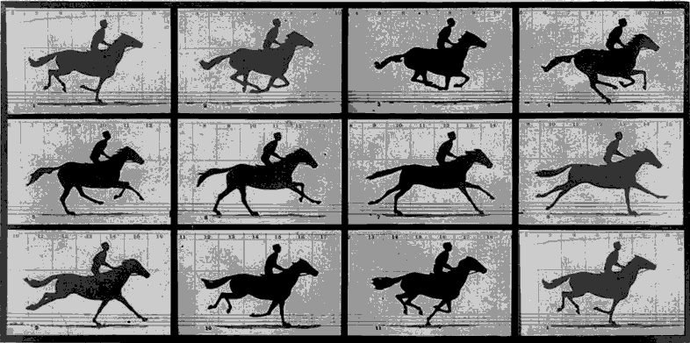
INtroduction
Motion video and computer-based animation have become basic media for multimedia system.
The visual effect of the motion is due to the biological phenomenon known as the persistance of vision
An Object seen by the human eye remains mapped in the eye for approx. 25ms
“ When two light sources are close by and are illuminated in quick succession, we percieve the single light source is moving between two points”
It is known that we percieve a continious motion to occour at a frame rate higher the 15 frames/ second.

Slide 3
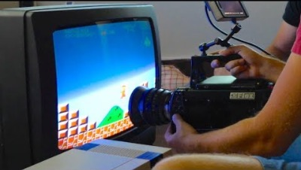
ViDeo Signal Representation

Slide 4
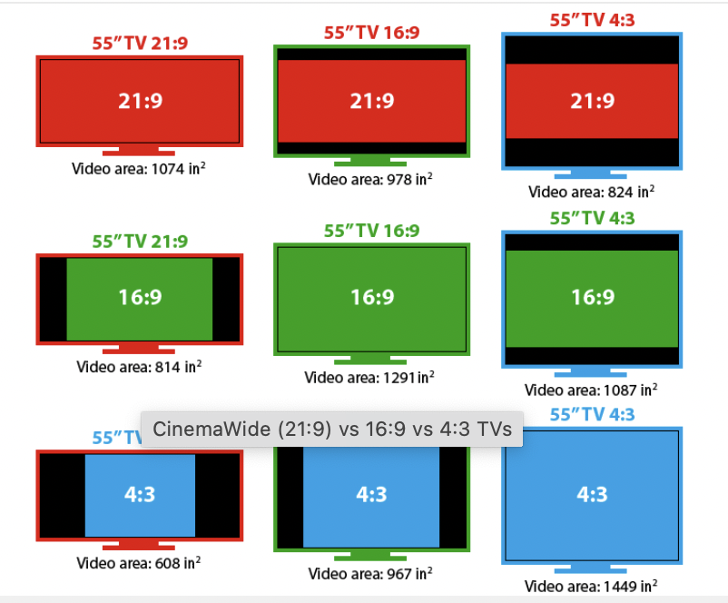
Measures for ViDeo Representation
1. Aspect Ratio
The aspect ratio is the ratio between the width and the height of a display.
It defines its overall shape, and it is usually presented as W:H (where W is the width, and H is the height).
All TVs sold today have an aspect ratio of 16:9, which means that if the width is divided into 16 equal parts, the height of the TV or picture should be 9 parts.
All the older TV’s and computer monitors you grew up with had the squarish 4:3 shape– 33% wider than it was high.
These are often referred to as square monitors

Slide 5
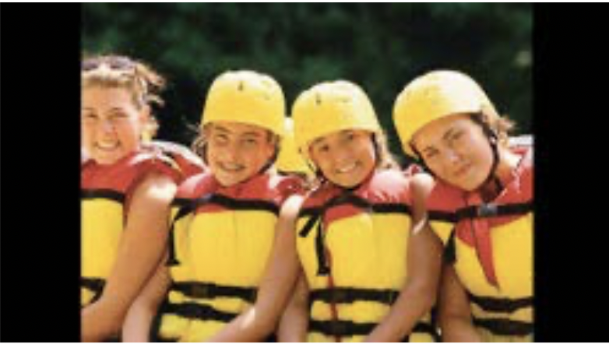


display a 4:3 video signal on a 16:9 monitor
1. Tolerate vertical black bars on the left and right sides of the screen (called “pillarboxing”),
2. Have horizontally stretched and distorted images, making people and objects appear shorter and wider:
3. Or zoom-in the video signal, which chops off the top and bottom portion of the images:

Slide 6
Measures for ViDeo Representation
2. Horizontal detail and Picture Width
The picture width chosen for conventional TV service is 4/3, 16/9.Using the aspect ratio, we can determine the horizontal field of view from the horizontal angle.
3. Total detail content of the image
The product of the number of elements vertically and horizontally equals the total number of picture elements in the image.
4. Perception of Depth
It is the perception of third spatial dimension that depends upon the angular seperation of the image reveived by the two eyes.
5. Luminance and Chrominance
The RGB gives a sence of color, but during the transmission of the signals from camera to the display, luminance & chrominance signals are used.

Slide 7
Measures for ViDeo Representation
6. Temporal Aspect of Illumination
Motion is the presentation of a rapid succession of slightly different still pictures. Between frames the light is cut off briefly.
To represent visual reality ,two conditions must be met.
First, rate of repetation must be high enough to gurantee a smooth transition.
Second, rate must be high enough so that the persistance of vision extends over the interval between the flashes
7. Continuity of Motion
Minimun 15 frames/second
USA(NTSC): 29.97Hz
Europe(PAL): 25 Hz
8. Flicker
Periodic fluctuation of brightness
Marginal value to aviod flicker is at least 50 refresh cycles/s
Flicker is a visible change in brightness between cycles displayed on video displays. It applies to the refresh interval on cathode-ray tube (CRT) televisions and computer monitors, as well as plasma computer displays and televisions.

Slide 8
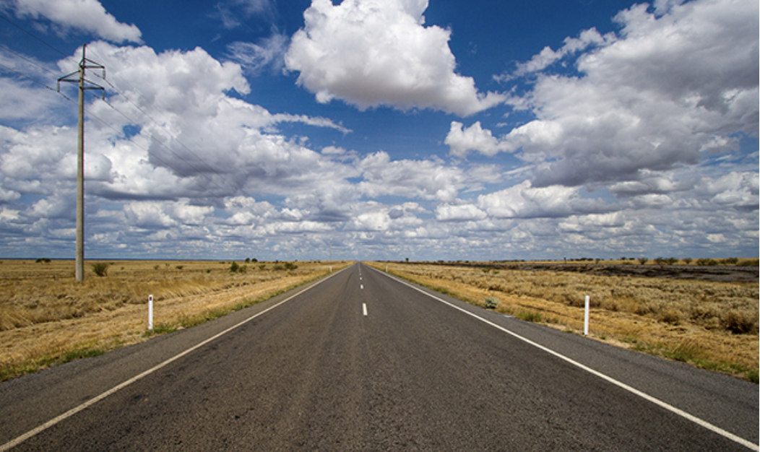
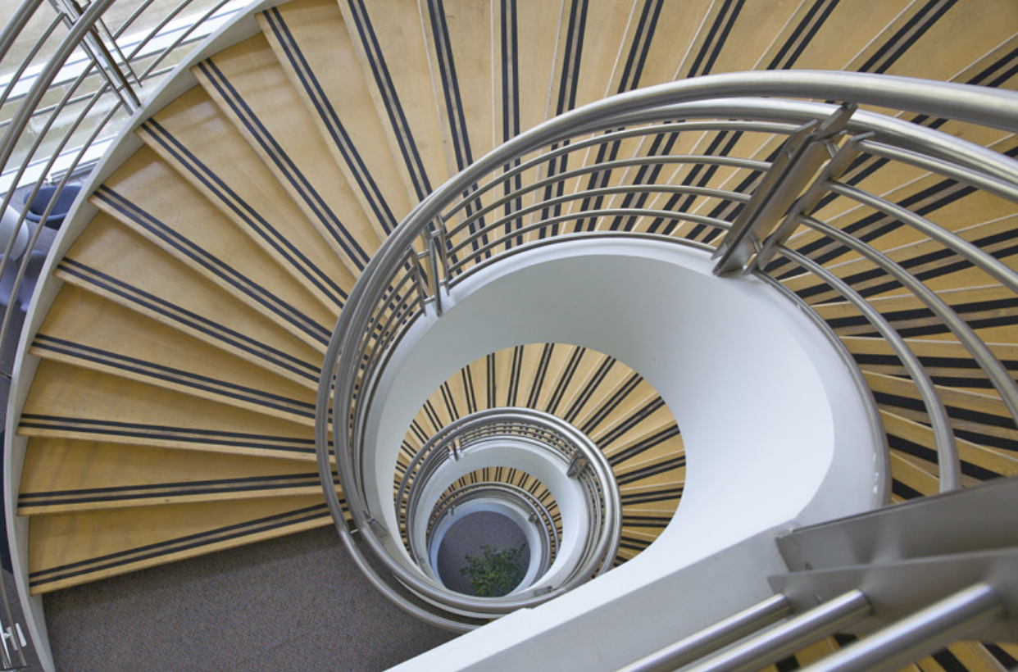
Depth perception .example

Slide 9
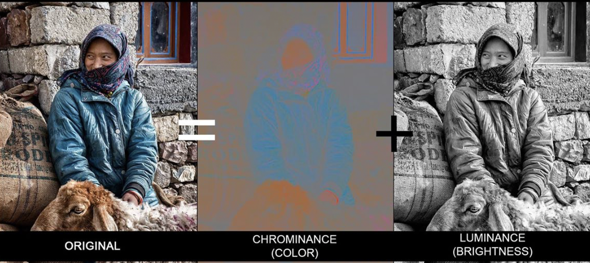

Luminance and chrominance. example

Slide 10
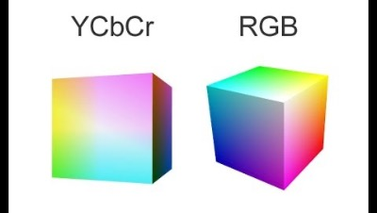
Color encoding

Slide 11
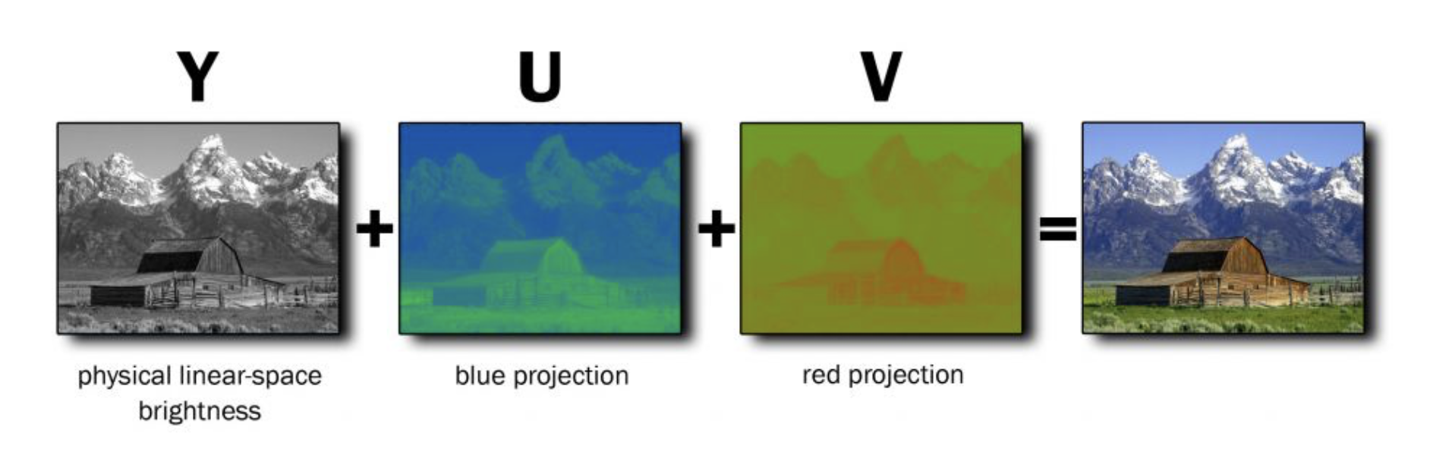
Color encoding (RGB+YUV)
The YUV color space is primarily used on an analog television.
YUV color space was particularly useful when color was first introduced to television as it could decode and display both color and black and white.
Like all color spaces, YUV is just an abbreviated term for ‘luma’, ‘red projection’ and ‘blue projection’.
Essentially, a YUV system is a mathematical encoding system like any other, but incorporates both brightness and color.
YUV is most useful for producing grayscale images, because all the user has to do is get rid of the U and V elements of the equation.

Slide 12
Color encoding (RGB+YUV)
The color encoding system used for analog television worldwide (NTSC, PAL and SECAM). The YUV color space (color model) differs from RGB, which is what the camera captures and what humans view.
When color signals were developed in the 1950s, it was decided to allow black and white TVs to continue to receive and decode monochrome signals, while color sets would decode both monochrome and color signals.
The Y in YUV stands for "luma," which is brightness.
U and V provide color information and are "color difference" signals of blue minus luma (B-Y)BLUE LUMA and red minus luma (R-Y)RED LUMA.
These corresponds approx. to the hue & saturation of the color.

Slide 13
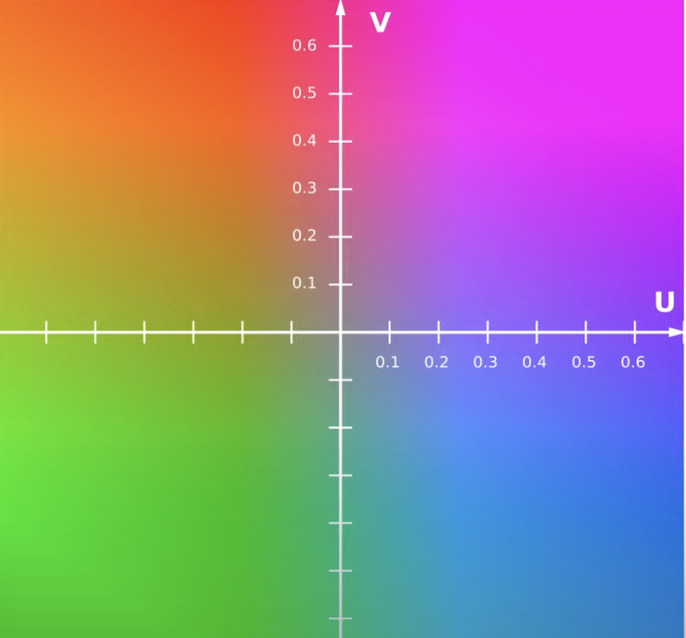
RGB to YUV and vice versa..conversion formula
From RGB to YUV
From YUV to RGB
Y = 0.299R + 0.587G + 0.114B
U = -0.147R - 0.289G + 0.436B
V = 0.615R - 0.515G - 0.100B
R = Y + 1.140V
G = Y - 0.395U - 0.581V
B = Y + 2.032U

Slide 14
Explanation
Our computers/Television sets physically use RBG channel signals.
When we are processing, boradcasting or storing it to a disk., then RGB is not always the useful format to store colours.Hence we use YUV .
Also called as YCbCr image, this has three values per pixel. Y is the luminance, it is the overlall brightness of the pixel.
This is effectively a greyscale value. If we igonore the U and V ,then we have a greyscale image.
Then U and V are the chorimance values which is the color information of the pixel . Blueness or redness.Ranges from –ve to +ve number
No green,Why? Since it is achieved when the redness and bluesness value is very small as seen in the graph.
Why seperation of RGB and YUV:For old blackand & white TV,if broascasters would send RGB signal to B&W tv, they would be able to see the TV. This process will ignore the color components and only channel the luminance singnal.
Another aspect is Chorma subsampling: For Compression:Human perception is more sensitive to the changes in brightness than in the changes in color.

Slide 15
T.V Systems. Broadcast Video Standards
1 National Television System Committee (NTSC)
NISC is a television broadcasting system used in a number of countries including Korea, Japan, Canada, North America, parts of South America, Mexico and the Caribbean islands.
It is named after the National Television Systems Committee, the industry wide standardization body that created it.
Set up in 1940 by the Federal Communication Commission in the United States to establish a nationwide standard for black and white TV transmission.
It specified a standard using 525 horizontal lines, 30 frames per sec, 2 interlaced fields per frame.
Lines: 525 Frame rate: 29.97 Hz Picture resolutions: 720 x 480; 704 x 480; 352 x 480; 352 x 240

Slide 16
T.V Systems. Broadcast Video Standards
2. Phase Alternating Line (PAL)
PAL, short for Phase Alternating Line, is the analogue video format used in television transmission in most of Europe.
PAL was developed in Germany by Walter Bruch, and first introduced in 1967.
The name “Phase Alternating Line” describes the way that part of the colour information on the video signal is reversed in phase with each line, which automatically corrects phase errors in the transmission of the signal.
Some engineers jokingly expand NTSC to “Never The Same Colour” while referring to PAL as “Perfect At Last” or “Peace At Last”!
The PAL colour system is usually used with a video format that has 625 lines per frame and a refresh rate of 25 frames per second.
Lines: 625 Frame rate: 25 Hz Picture resolution: 720 x 576; 704 x 576; 352 x 576; 352 x 288

Slide 17
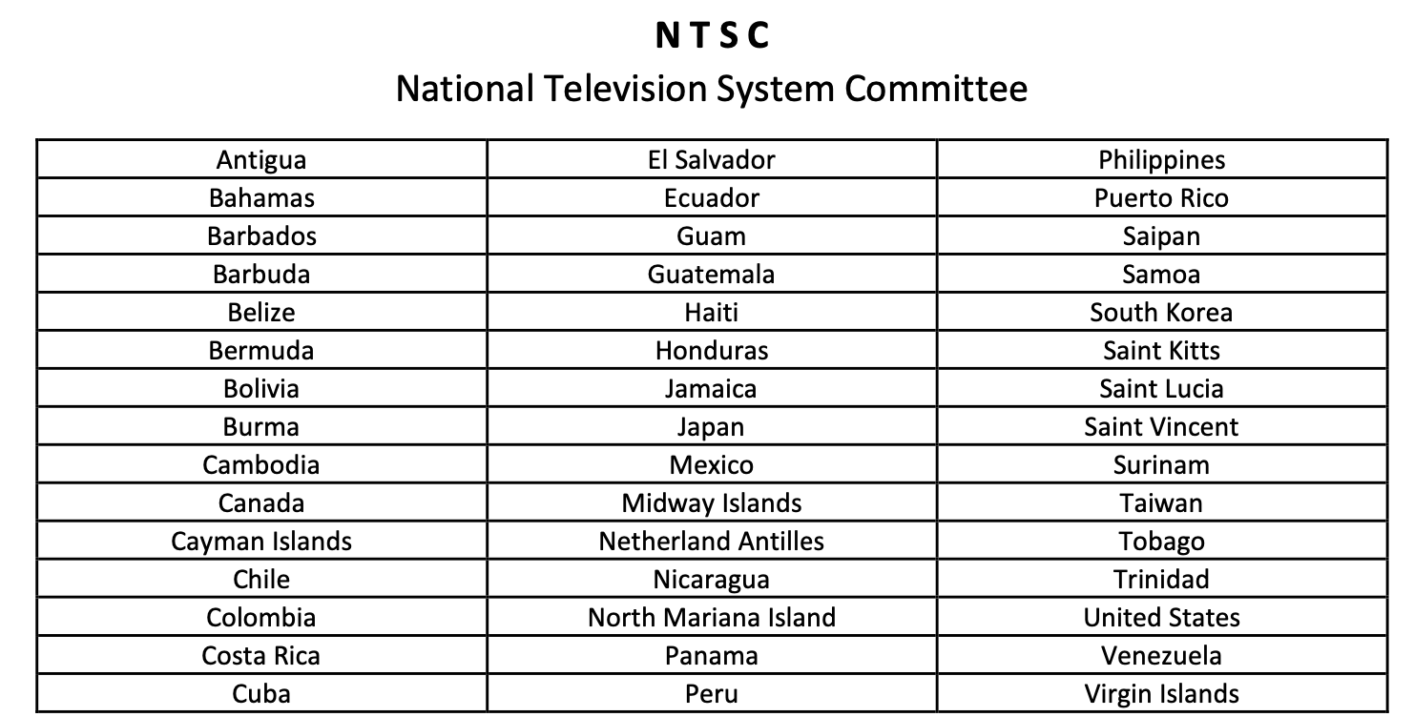
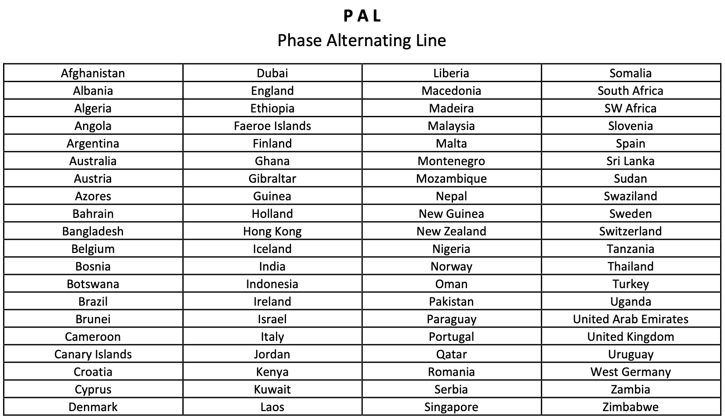
List of Countries and their NTSC or PAL Television Format

Slide 18
T.V Systems. Broadcast Video Standards
3. Systeme Electronique Pour Couleur Avec Memoire (SECAM)
SECAM is an analogue television system, using frequency modulation to encode chrominance information.
SECAM was introduced in France in 1967, where it is still used.
SECAM was developed arguably to protect French television equipment manufactures and to make it more difficult to view non-French programming.
SECAM removes colour artefacts but halves colour resolution.
SECAM uses the same bandwidth and resolution (720x576) as PAL

Slide 19
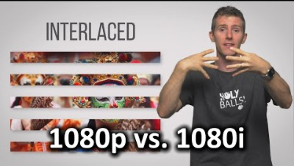
Progressive and Interlaced scan

Slide 20
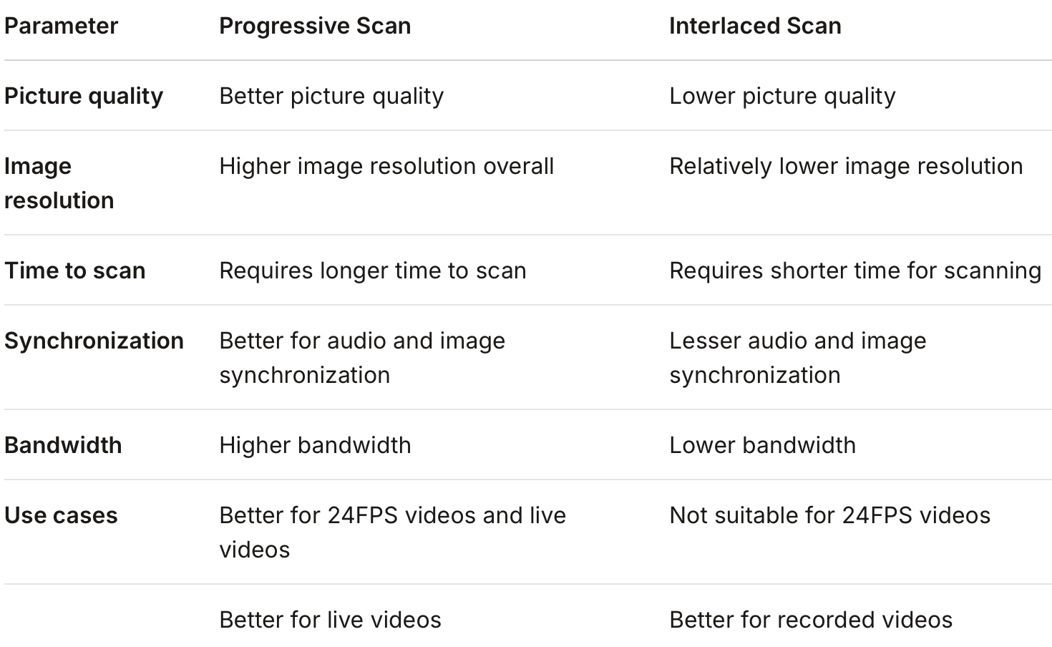
Progressive vs Interlaced scan
Progressive
Interlaced
It is a process where every frame of the video signal is scanned in a progressive way. Each frame is scanned as a complete picture.
Works by scanning every second frame of a video signal. Every second frame is then combined to create a full video frame.

Slide 21
File size calculation for video
A Video with resolution of 704x576 size, with 30 frames per second, running for a 90 minute length, and has 24 bit per pixel color coding. The video is in an uncompressed raw format. What is the total file size in Megabytes?
There are 8 bits in a byte, so 24 bits per pixel implies 3 bytes per pixel.
704 × 576 pixels × 3 bytes per pixel × 30 frames per second ÷ (1024 × 1024 bytes per megabyte) ≅ 34.8 MB/s = 278.4 Mb/s.
'MB' is megabytes, 'Mb' is megabits. Don't conflate them, because you'll be off by a factor of 8.
Total data = 34.8 MB/s × 60 seconds per minute × 90 minutes ÷ (1024 megabytes per gigabyte) ≅ 183.5 GB.

Slide 22
Animation and its types
To animate something is, literally, to bring it to life.
An animation covers all changes that have a visual effect
Visual effect can be of two major kinds:
Motion dynamic & Update dynamic
A computer animation is an animation performed by a computer using graphical tools to provide visual effects
✓ Traditional Animation
✓ Stop Motion
✓ Computer Animation

Slide 23
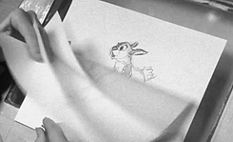
Traditional Animation
Traditional animation (also called cel animation or hand-drawn animation) was the process used for most animated films of the 20th century.
The individual frames of a traditionally animated film are photographs of drawings, which are first drawn on paper.
To create the illusion of movement, each drawing differs slightly from the one before it.
Examples of traditionally animated feature films include Pinocchio (United States, 1940), Animal Farm (United Kingdom, 1954), and Akira (Japan, 1988). Traditional animated films which were produced with the aid of computer technology include The Lion King (US, 1994).

Slide 24
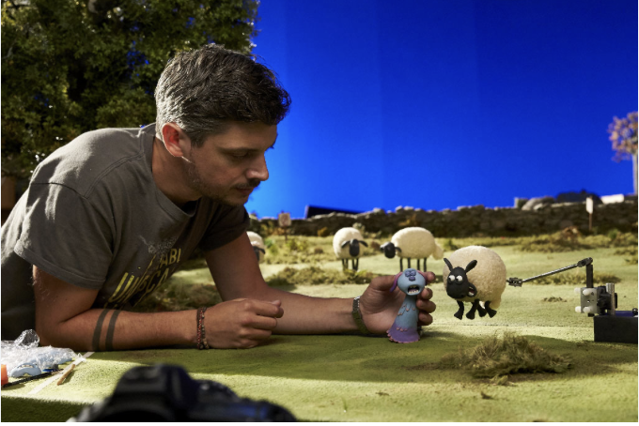
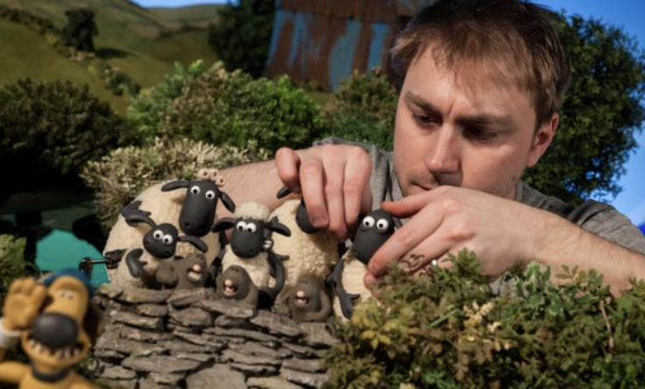
Stop Motion
Stop-motion animation is used to describe animation created by physically manipulating real-world objects and photographing them one frame of film at a time to create the illusion of movement.
Examples include The Tale of the Fox (France, 1937), The Nightmare Before Christmas (US,1993), Corpse Bride (US, 2005), Coraline (US, 2009)

Slide 25
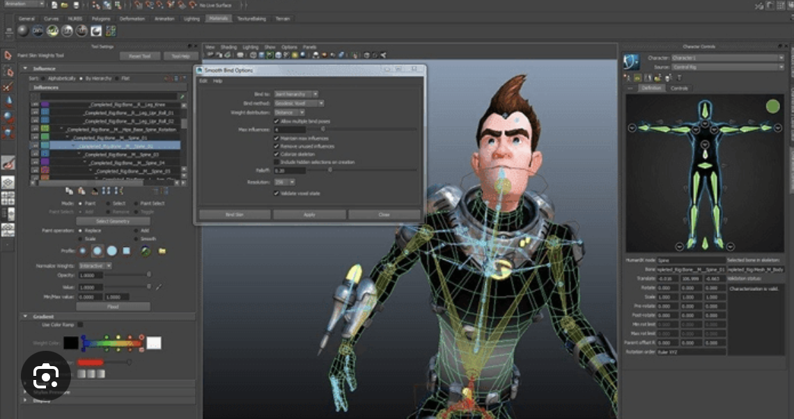
Computer Animation
A computer-based animation is an animation performed by a computer using graphical tools to provide visual effects.
Computer animation encompasses a variety of techniques, the unifying factor being that the animation is created digitally on a computer.
This animation takes less time than previous traditional animation.

Slide 26
Computer animation can broadly be categorized into two categories:
Motion Dynamics
Induction of life by changing the position of the object
Example: Animation of a bouncing ball
Update Dynamics
Induction of life by changing the shape, size, color, transparency, textures, and structure of the object
Example: Animation of flower blooming from bud.

Slide 27
Fundamental process in Animation 1. Input Process
The first step in producing computer animation is input process.
Key frames have to be created and input them to the computer.
Key frames are the frames in which the objects being animated are at extreme or characteristic positions.
They can be drawn using traditional artistic tools, such as pen and brush, and then digitized.
They can also be created using drawing or painting tools directly.
In composition stage, the foreground and background figures are combined to generate the individual frames.

Slide 28
Fundamental process in Animation 2. Inbetween Process
The animation of movement from one position to another needs a composition of frames with intermediate positions in between the key frames
The process of in between-ing is performed in computer animation through interpolation
The system is given the starting and ending positions
It calculates the positions in between the frames.

Slide 29
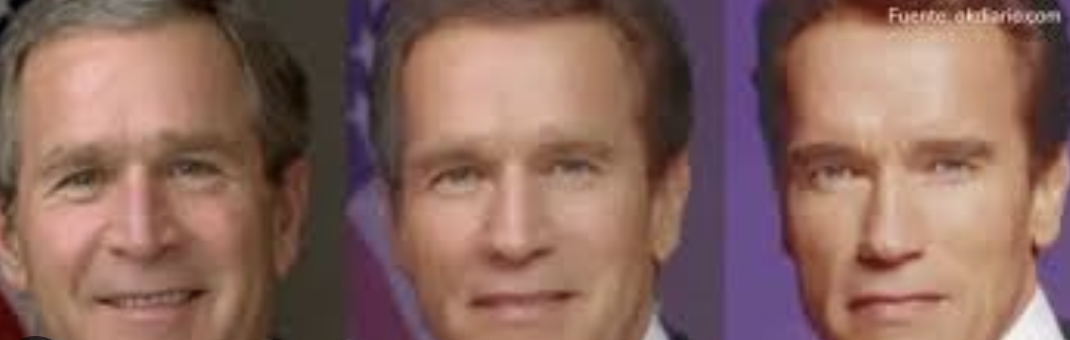
2. Inbetween process..contd
The easiest interpolation is linear interpolation
It has many limitations: the object does not move smoothly, look unreal.
Spline interpolation can make object move more smoothly . Inbetweening also involves interpolating the shapes of objects
Some animation involves changing the color of objects
This is usually done using color look-up table (CLUT)
By cycling through the colors in the CLUT, the objects’ colors will change
Morphing is a popular effect in which one image transforms into another.

Slide 30
Controlling animation
Full explicit control —the animator provides a description of everything that occurs in the animation
Either by specifying simple changes, such as scaling, transformation or by providing key frames
Procedural control —using a program to calculate the position, angle, etc. of the objects
In physical systems, the position of one object may influence the motion of another
Constraint-based systems —movement of objects that are in contact with each other is constraint by physical laws
An animation can be specified by these constraints
Tracking live action
People or animals act out the parts of the characters in the animation
The animator trace out the characters

Slide 31
Displaying animation
The rules governing the showing of video apply to animation as well .The frame rate should be at least 10, preferably 15 to 20, to give a reasonably smooth effect
There are basically three common ways to display animation
1.Generate a digital video clip
Many Animation tools will export an animation in common digital video format, e.g., QuickTime
2.Create a package including runtime system of the animation tool
For example, Director can create a projector including all casts. The projector can then be distributed and play the animation.
3. Show the animation in the animation tool

Slide 32
Animation tools
Macromedia Director and Flash
It is one of the most popular interactive animation tool for generating interactive multimedia applications.
Meta Creations Poser
It understands human motion and inverse kinematics, e.g., move an arm the shoulders will follow.
Discreet 3D Studio Max
Very popular for creating 3D animations
Animation language—VRML (Virtual Reality Modeling Language)

Slide 33
End of chapter 4

